Slide 1
CMPS 480:
FINAL PROJECT
By Antonio Flores Marquez, Julian Jimenez Gonzaga

Slide 2
THE PROBLEM
The purpose of this app is for students who are taking a Math class
Features in this app include Default Calculator, Find the Slope, Area and Perimeter, Midpoint, Random Integer

Slide 3
01
Home
02
Default Calculator
03
Find Slope
04
Area and Perimeter (Circle, Rectangle, Square, Triangle)
05
Midpoint
06
Random Integer Page
07
Demo

Slide 4
01
HOME
x
y

Slide 5
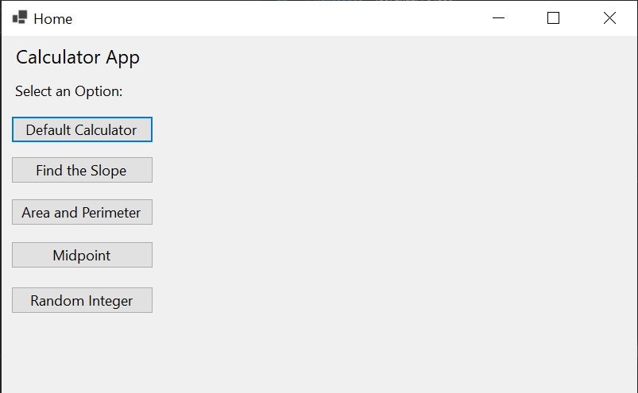
HOME
The user can select from various options such as
Default Calculator
Find the Slope
Area and Perimeter
Midpoint
Random Integer

Slide 6
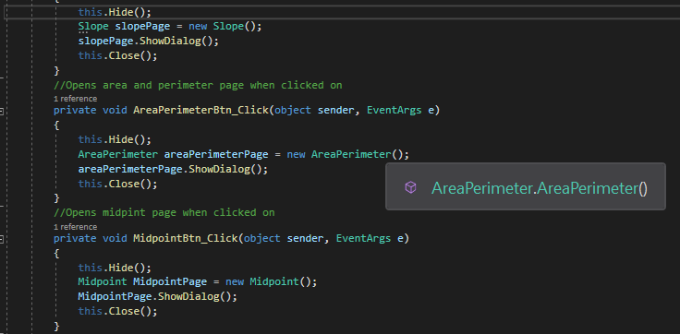
HOME
When a button is pressed it performs a similar, but different action
When a button is pressed, it will open a new page with the corresponding option

Slide 7
02
DEFAULT CALCULATOR

Slide 8
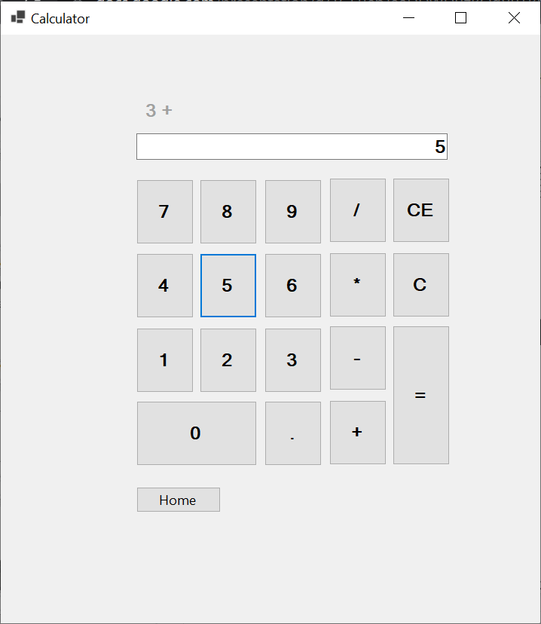
DEFAULT CALCULATOR
The default calculator works like any standard calculator with operations such as:
Addition
Subtraction
Multiplication
Division

Slide 9
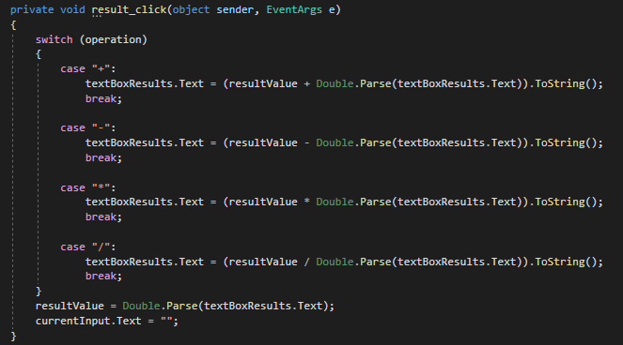
DEFAULT CALCULATOR
The operations for the calculator are done through a switch statement
Each operation has its own corresponding button which is then used when solving for the answer

Slide 10
03
FIND SLOPE

Slide 11
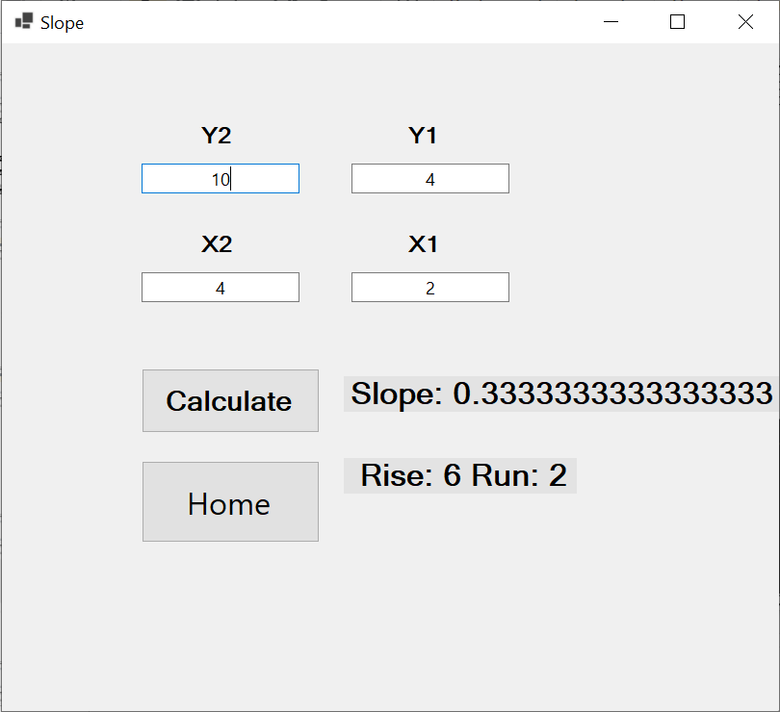
FIND SLOPE
The Find Slope takes four inputs from the user Y2, Y1, X2, and X1

Slide 12
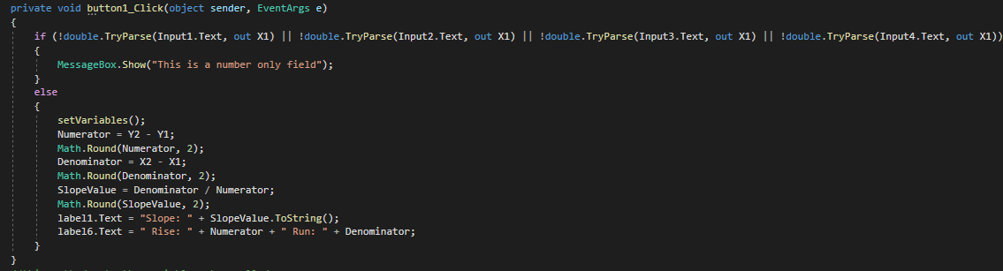
FIND SLOPE
Find Slope uses the formula (Y2-Y1)/(X2-X1)
Once the user has all the inputs, and presses the calculate button it will display the slope, and the rise, and the run

Slide 13
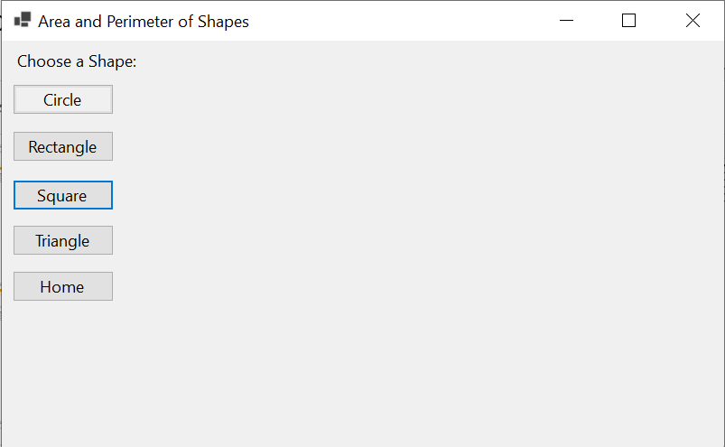
04
AREA AND PERIMETER
CIRCLE, RECTANGLE, SQUARE, TRIANGLE

Slide 14
AREA AND PERIMETER
The user has the option to pick four different shapes in order to find the Area and Perimeter

Slide 15
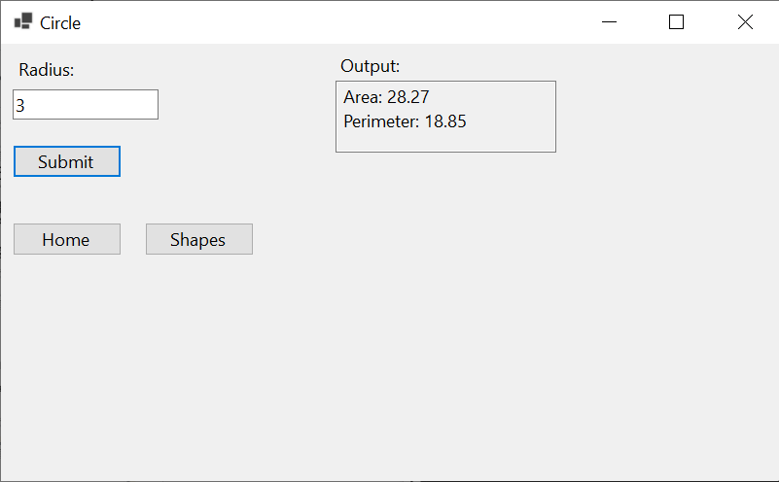
CIRCLE
The user is prompted to enter one integer in order to find the Area and Perimeter

Slide 16
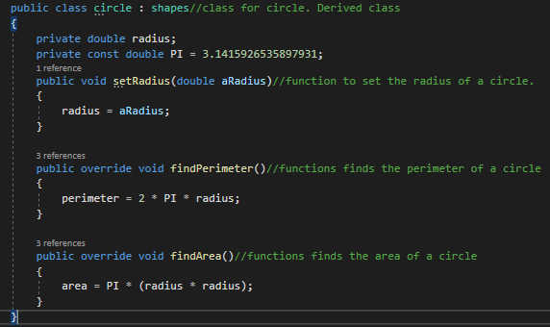
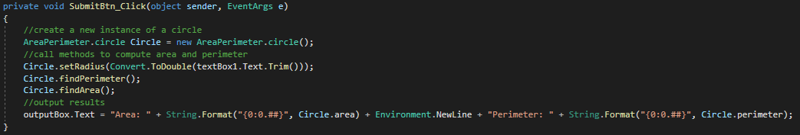
CIRCLE
The formulas to find the Area and Perimeter are all different

Slide 17
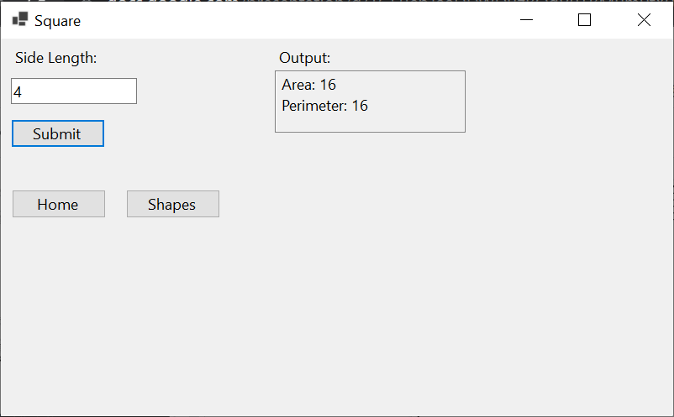
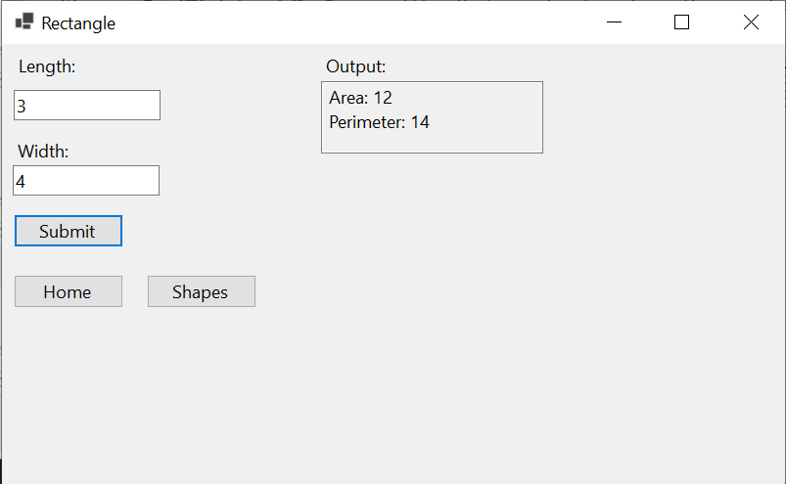
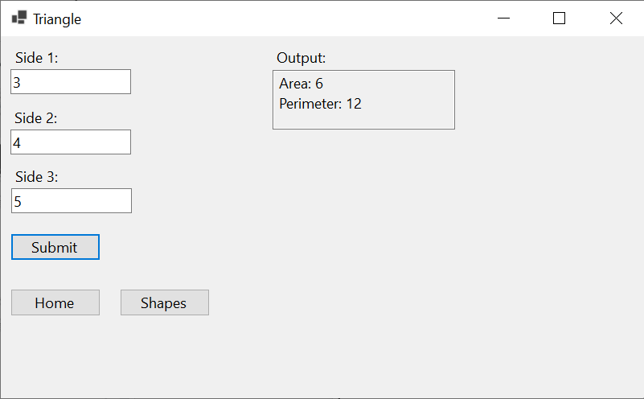
AREA AND PERIMETER
Circle Requires radius
Square requires side Length
REctangle = Requires Length and Width
Triangle requires three different

Slide 18
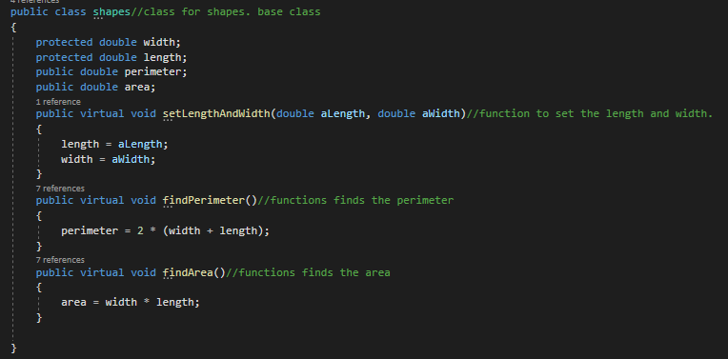
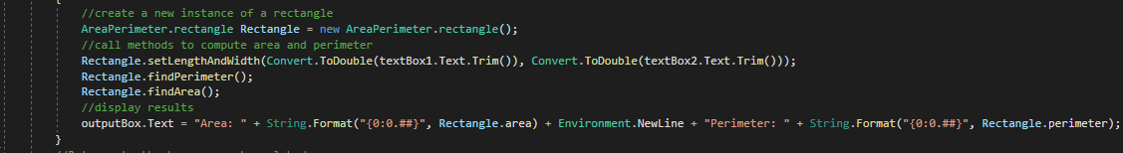
RECTANGLE

Slide 19
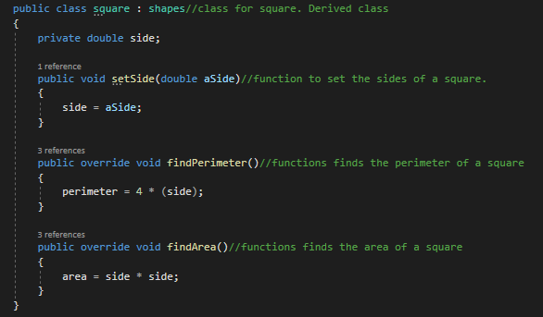
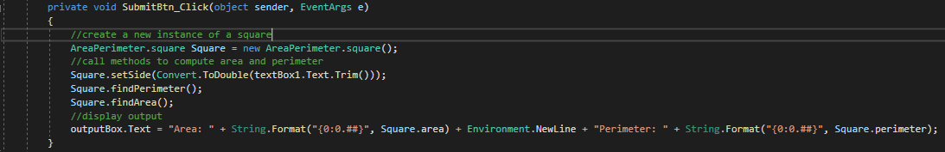
SQUARE

Slide 20
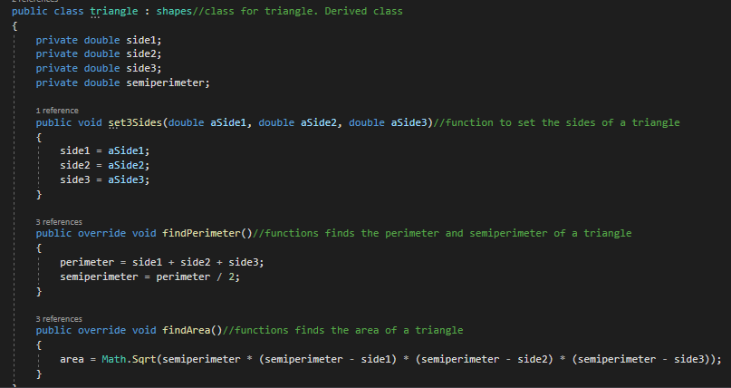
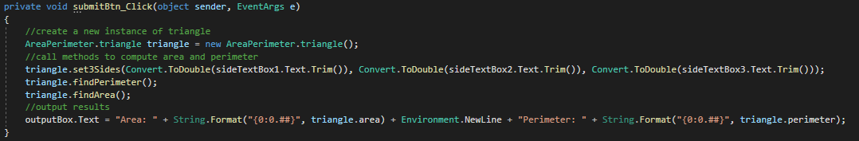
TRIANGLE

Slide 21
05
MIDPOINT
x
y

Slide 22
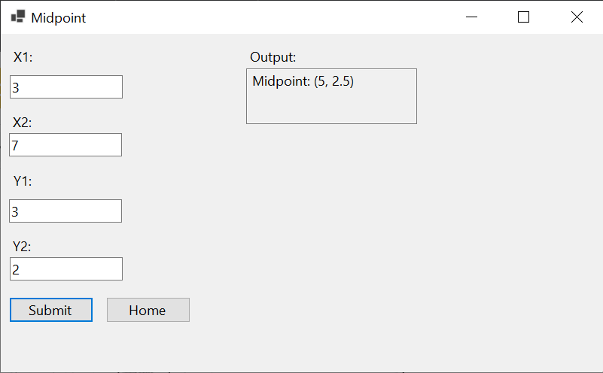
MIDPOINT
In order to find the Midpoint, the user is prompted to input X1, X2, Y1, and Y2

Slide 23
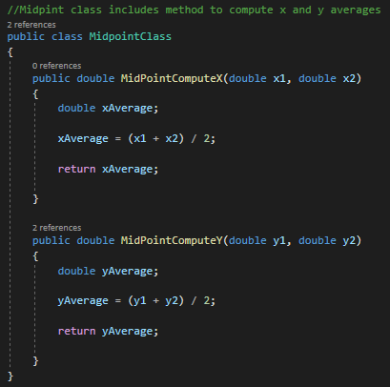
MIDPOINT
In order to find the Midpoint the user needs 4 inputs
Both the X inputs, and Y inputs are averaged in order to find the Midpoint

Slide 24
06
Random Integer PAGE

Slide 25
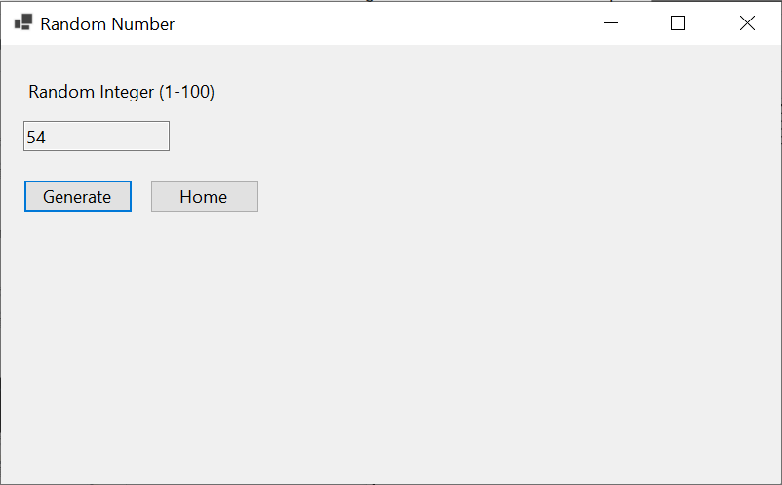
MIDPOINT
The user can press a button which will generate a random number

Slide 26
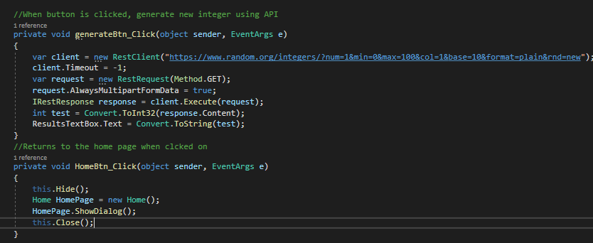
MIDPOINT
When the button is clicked it will generate a random integer, and then convert it into a string in order to display it

Slide 27
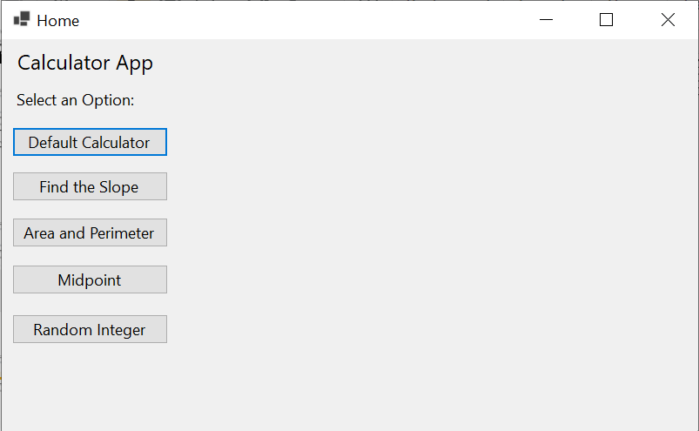
07
DEMO

Slide 28
Thank You!
Any Questions?

